Slide 1
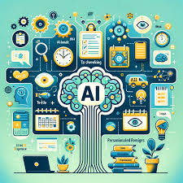
SMART AI-FREE DAILY ROUTINE OPTIMIZER
Presented By
Student Name: Dipanshu dhage

Slide 2
OUTLINE
Problem Statement
Proposed System/Solution
System Development Approach
Algorithm & Deployment
Result (Output Image)
Conclusion
Future Scope
References

Slide 3
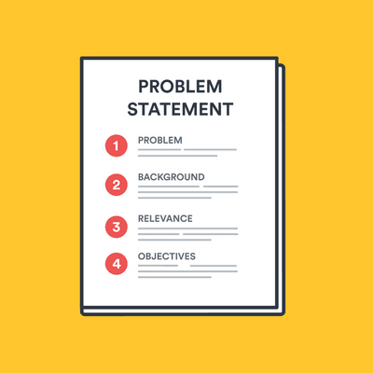
Problem Statement
In today’s fast-paced world, many people fail to manage their daily time efficiently.
Lack of personalized routines leads to low productivity, mental fatigue, and burnout.
Most existing planners are rigid and don’t adapt to user energy levels or goals.
People need an intelligent yet simple tool to create a productive, balanced schedule.

Slide 4

Proposed Solution
A smart, interactive web application that generates an optimized daily routine based on:
Wake-up and sleep times
Daily priorities (like study, work, exercise)
User’s peak focus time (morning, afternoon, evening)
The system offers:
Automatic schedule generation
Smart suggestions
Visual time distribution
Downloadable daily plan

Slide 5
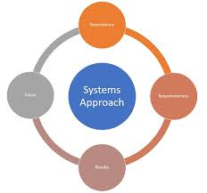
System Approach
Frontend Interface:
Streamlit for real-time user input and display
Backend Logic:
Python for schedule algorithm
Data Visualization:
Matplotlib for pie charts
Pandas for managing time slots
Other Tools:
StringIO for text export
No external API to keep it lightweight and offline-friendly

Slide 6
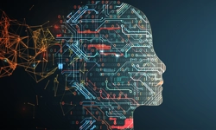
Algorithm & Deployment
Algorithm Overview:
Accept inputs: wake-up time, sleep time, selected tasks, and focus period.
Calculate available hours between wake and sleep time.
Assign 1 hour to each task, then distribute the remaining time randomly.
Create a timeline of tasks hour-by-hour starting from wake-up time.
Offer suggestions and visualize time distribution.
Deployment:
Run locally via Streamlit run app.py
Easy to host on platforms like:
Streamlit Cloud
Render or Heroku (if needed)

Slide 7
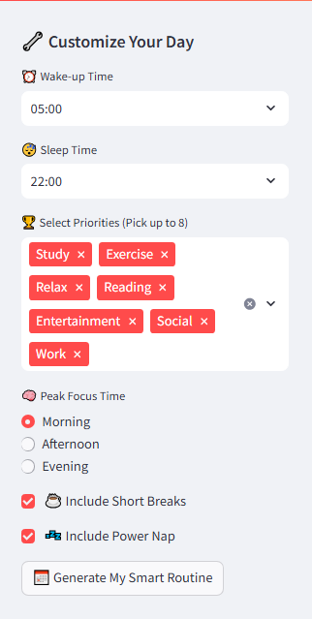
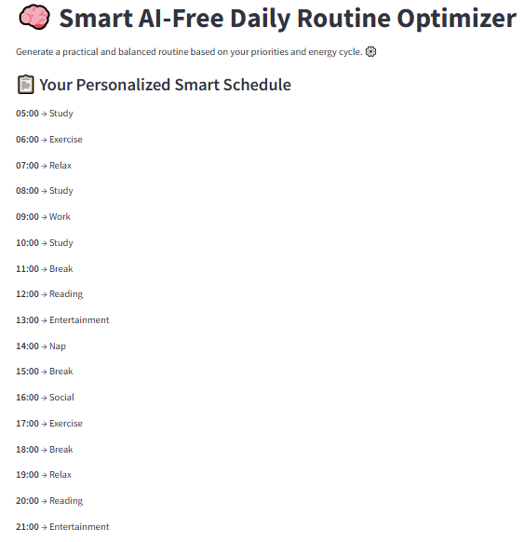
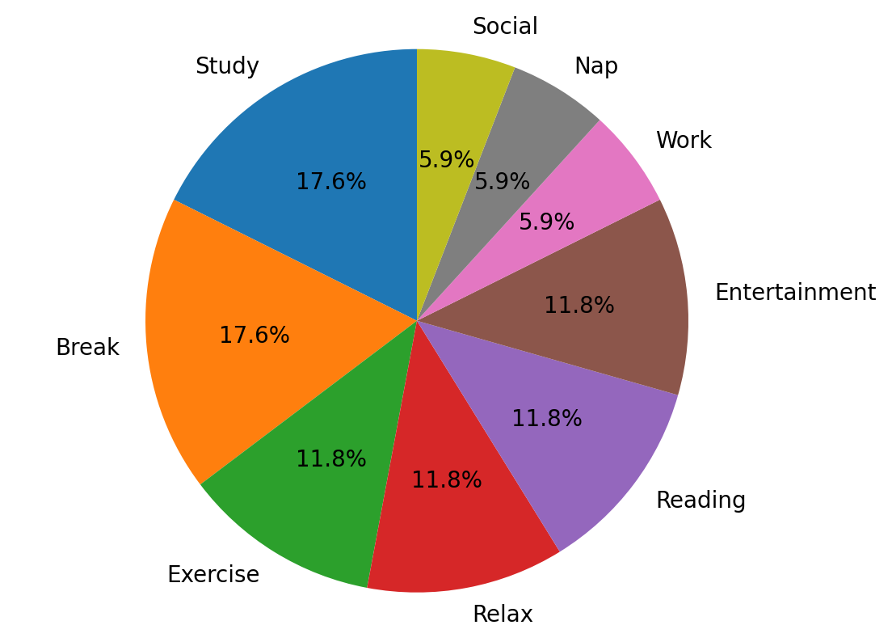
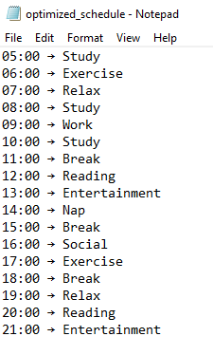
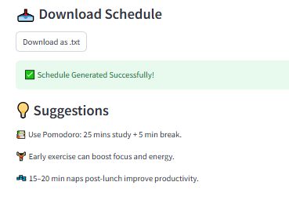
Result

Slide 8

Conclusion
The AI-Powered Daily Routine Optimizer empowers users to manage their day efficiently.
It provides a fully personalized schedule without the need for complex setup or paid APIs.
The solution is lightweight, intuitive, and practical for everyday use.
It promotes healthy work-life balance and productivity

Slide 9
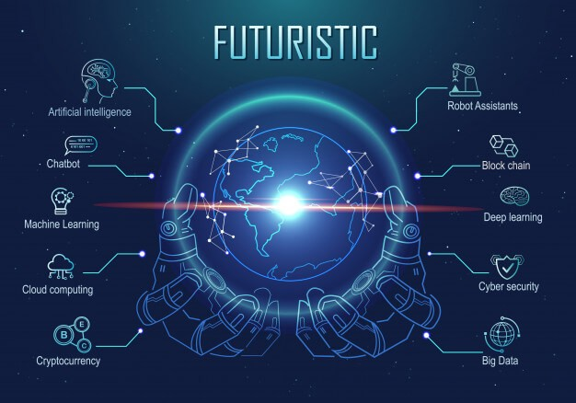
Future scope
Possible Future Enhancements:
Integration with Google Calendar
Add user login and schedule history
Provide AI feedback to improve time use based on past patterns
Integration with Notion, Todoist, or other productivity apps
Add health & habit tracking modules

Slide 10

References
Streamlit Documentation: https://docs.streamlit.io
Matplotlib Docs: https://matplotlib.org
Pomodoro Technique: https://francescocirillo.com
Productivity Research Blogs & AI Routine Concepts
GitHub:https://github.com/dipanshudhage/AI-Daily-Routine-Optimizer

Slide 11
Thank you

